Slide 1

205SE
Programming for Engineers
Tutorial 2
Variables
Chris Bass

Slide 2



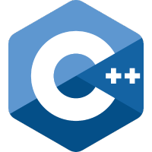
Last Tutorial
CU GitHub for source control
git clone, git commit, git push
Microsoft Visual Studio IDE
Created a Win32 Console Application
  Win32 Windows API 32bit operating system
  Console means a text-based interface
Hello World! application in C++
Extended to add ASCII Art
Purpose of demonstrating text-based output to the console using the cout object
Chris Bass

Slide 3

Today
8 Activities + 2 Homeworks to get through!
Variable definition statement
Using the cin object
Variables and Scope
Conditional Statements
Boolean Expressions
Visual Studio Debugger
Fun Coding Games
Chris Bass

Slide 4
Variable definition statement
  Introduces a new identifier, associates the identifier with a type specifier, and allocates the required memory space for it
“This thing exists here, make space in memory for it”
Can only have one definition per identifier per scope
  lowerCamelCase is the naming convention for variable names
{
int totalStudents;
}
type specifer
identifier
totalStudents only exists inside this scope
Chris Bass

Slide 5
Variable initialisation
Giving an initial value to a variable where no previous value is given
{
int totalStudents;
totalStudents = 54;
totalStudents = 63;
}
Only one definition for totalStudents
Storing an initial value of 54
Assigning a new value of 63
The assignment operator evaluates the right hand side expression first then assigns to the left
Chris Bass

Slide 6
Starting the Tutorial Work
If you are on a new PC then you will have to clone your source code repository from last time
Navigate to our CU GitHub page and find your remote repository:
  https://github.coventry.ac.uk/205SE-1920SEPJAN /<your username>-tutorialwork
Click ‘clone or download’ and copy the URL
Chris Bass

Slide 7
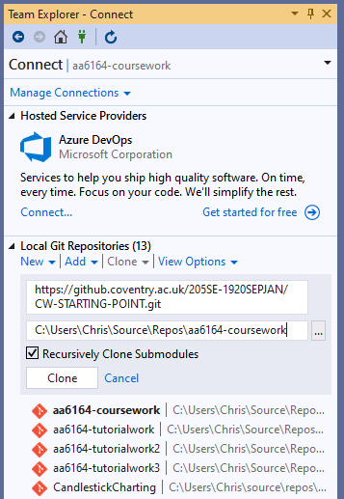
Clone a remote repo
In Team Explorer click manage connections
Under ‘Local Git Repositories’ click the clone dropdown and paste the URL of the remote repo.
Next modify the directory to save under as <username>-tutorialwork e.g. aa6164-tutorialwork
Click the clone button and then double-click the cloned repository to open it
Chris Bass

Slide 8
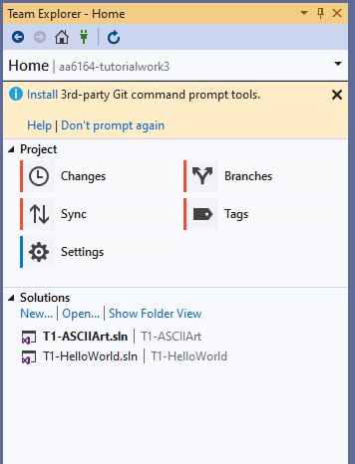
Create a new solution for today’s work
Let’s add a Visual Studio Solution to the local and remote repositories
In Visual Studio under Team Explorer, local repository, Home → Solutions click ‘New’
The normal ‘Create a new project’ window will popup and we want to create a C++ ‘Console App’
Create one solution called ‘T2-Variables’ and optionally repeat the process to create another solution called ‘T2-Selection’
You can double-click on a solution to switch between them
Chris Bass

Slide 9

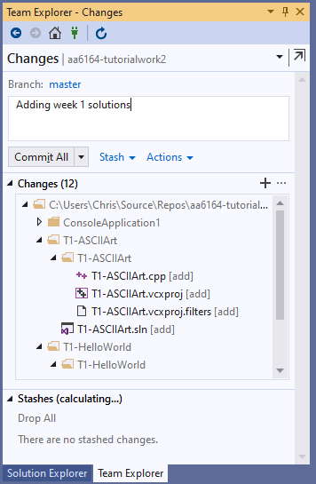
Commit changes
Now we have made some changes we can commit (save) these to our local repository
Home → Changes → add a commit message and click Commit All
Chris Bass

Slide 10

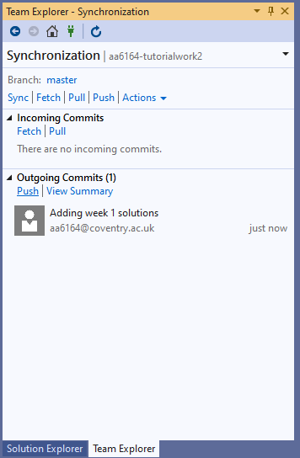
Push local commits to remote
Now we can update our remote repository with the commits we have locally
Home → Sync → Outgoing Commits → Push
Chris Bass

Slide 11

Activity 1 – Output variables
Open your new solution
Define a new variable using the int keyword
Using cout print the value on the console window
Notice the difference in syntax between outputting a string literal vs. outputting a variable
What happens if we try to print out a variable that has not been initialised?
Experiment with integer arithmetic operators + - * / % and output the results onto the console window
Chris Bass

Slide 12

Activity 2 – Input
So far we have been using the cout object and the insertion operator << for console output
Now let’s try using the cin object and the extraction operator >> to read and store an integer
First prompt the user to input a variable
cin >> myInput;
Chris Bass

Slide 13
Activity 3 – Multiple inputs
Write a program which prompts for and accepts 3 integers as input from the user, multiplies them together and writes the result back to the console (Deitel Ch02 Ex05)
Chris Bass

Slide 14

Blocks
A block of code starts and ends with a curly bracket
The compound statements to be executed are placed in-between them
From the outside a block acts in a similar manner to a black box i.e. you cannot see inside, but from the inside you can see outside
{ // start of a block
// statements to be executed
} // end of a block
Chris Bass

Slide 15
Scope and local variables
Scope determines who can see what
Local variables are defined inside a block, they have block scope, and are invisible outside of the block
{
int localVariable = 5;
// localVariable exists here
} // localVariable memory is freed
// localVariable does not exist here
A new block gives rise to a new level of scope. We can use tabbing to visualise scope changes.
Chris Bass

Slide 16

Global variables
Global variables are declared outside of any scope, they are visible and can be modified from anywhere in the program
They can conflict with other software modules
Usage is usually considered as bad practice
Favour local variables over globals, the more encapsulation the better
int globalVariable; // global scope
int main() { // scope change
int localVariable; // local to the main
return 0;
} // scope change
Chris Bass

Slide 17
Activity 4 – Scope
Add the following code somewhere inside your main function, what is the output?
int local = 3;
{
cout << local << endl;
int local = 4;
cout << local << endl;
}
cout << local << endl;
Chris Bass

Slide 18

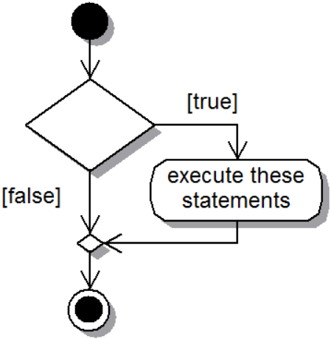
Selection statement – if
if(true)
{
// execute
// these
// statements
}
Chris Bass

Slide 19

Boolean Expressions –
Relational/Equality/Comparison Operators
Boolean expression equate to either True or False only
== | Equal to
!= | Not equal to
> | Greater than
< | Less than
>= | Greater than or equal to
<= | Less than or equal to
Chris Bass

Slide 20
Boolean Expressions –
Relational/Equality/Comparison Operators
Boolean expressions equate to either True or False only
[left == right] [left equal to right returns true]
[left != right] [left not equal to right returns true]
[left >= right] [left greater than or equal to right returns true]
[left <= right] [left less than or equal to right returns true]
[left > right] [left greater than right returns true]
[left < right] [left less than right returns true]
Chris Bass

Slide 21

Boolean Expressions –
Logical Operators
Boolean expression equate to either True or False only
&& Logical AND
|| Logical OR
! Logical negation NOT
[left && right] [left true and right true returns true]
[left || right] [left true or right true returns true]
[! false] [not false returns true]
Chris Bass

Slide 22
Activity 5 – Selection
Write a program which accepts 2 integers as input from the user, compares them to find which is greater than, less than, equivalent, not equivalent, and writes the result back to the console (Deitel Ch02 Fig13)
Adapt this program to do the same for 3 integers
Chris Bass

Slide 23

Activity 6 – Debugging
Add a breakpoint by clicking in the left hand grey margin the line will highlight in red
Start debugging
Notice the program pauses execution at the breakpoint
The green arrow points to the next line to execute
Use the step over button to execute the next line
Notice how debugging works with if conditions
Also notice you can hover the mouse over variables to see their values
Chris Bass

Slide 24
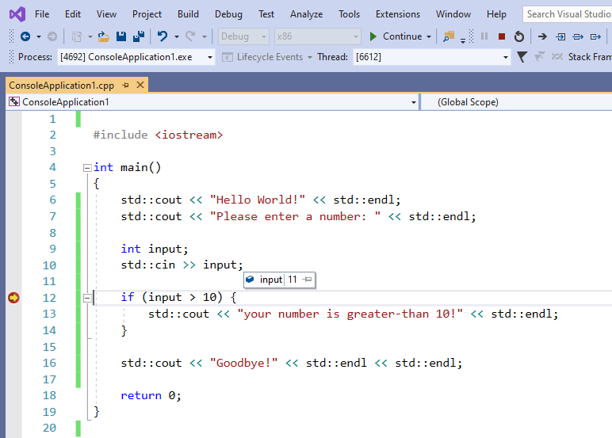
Step over executes 1 line at a time
Input variable contains the data 11
Breakpoint pauses the debugger, yellow arrow is next statement to execute
Chris Bass

Slide 25

CodinGame Activity 7
Break into mini competition groups (desk of 6?)
With everyone on your desk/group starting at the same time, (wait/help the rest of the group to complete the previous task first), see who can solve the following CodinGame puzzle first:
Mars Lander – Episode 1:
  https://www.codingame.com/training/easy/mars-lander-episode-1
(You will need to sign up for an account with them or use your google account etc.)
It has its own web browser based IDE
Chris Bass

Slide 26
CodinGame Activity 8
Break into mini competition groups (desk of 6?)
With everyone on your desk/group starting at the same time, (wait/help the rest of the group to complete the previous task first), see who can solve the following CodinGame puzzle first:
Power of Thor – Episode 1:
  https://www.codingame.com/training/easy/power-of-thor-episode-1
(You will need to sign up for an account with them or use your google account etc.)
It has its own web browser based IDE
Chris Bass

Slide 27

Homework 1 – Grading Program
Write a program that allows the user to enter the grade scored in a programming class (0-100).
If the user scored a 100 then notify the user that they got a perfect score.
Easy ★ Modify the program so that if the user scored from 90-100 it informs the user that they scored an A
Hard ★★ Modify the program so that it will notify the user of their letter grade 0-59 F 60-69 D 70-79 C 80-89 B 90-100 A
Chris Bass

Slide 28
Homework 2 – Cola Machine
Write a program that presents the user w/ a choice of your 5 favourite beverages (Coke, Water, Sprite, Tango, Vimto).
Then allow the user to choose a beverage by entering a number from 1-5.
Output which beverage they chose.
Easy ★ If you program uses if-statements instead of a switch-case statement, modify it to use a switch-case statement.
Hard ★★ Modify the program so that if the user enters a choice other than 1-5 then it will output "Error. choice was not valid, here is your money back."
Chris Bass

